Slide 1

IB Integrated Design Project
Group Name: “Not quite M1”
Max Karous
Sebastian Burgess
Niall Keating
Sinéad Foley
Alicia Torres Gómez
Léa Gansser Potts
Diego García Medina

Slide 2
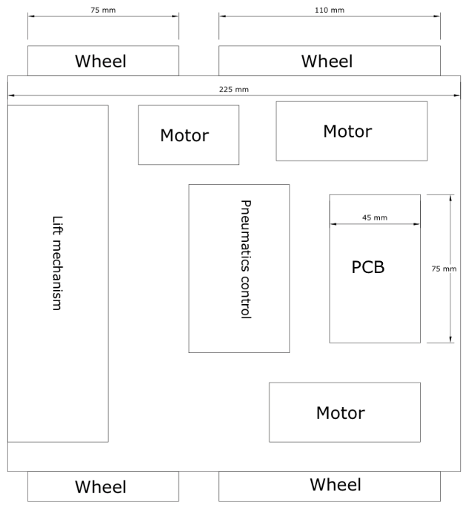
Mechanical Subteam
Max & Sebastian
Layout
Initial ideas were to make the robot small which allows us to create a mechanism that can protrude slightly.
It is also maneuverable, using two caster wheels at the front for control and specially stability on the ramp especially.
The pneumatic controller must be in proximity of the lift mechanism, giving it central priority.
Problems
This setup means we are unable to pick up multiple boxes, or store them while in transit, however if the actuator mechanism is stable and can apply enough force, the box should be secure.

Slide 3
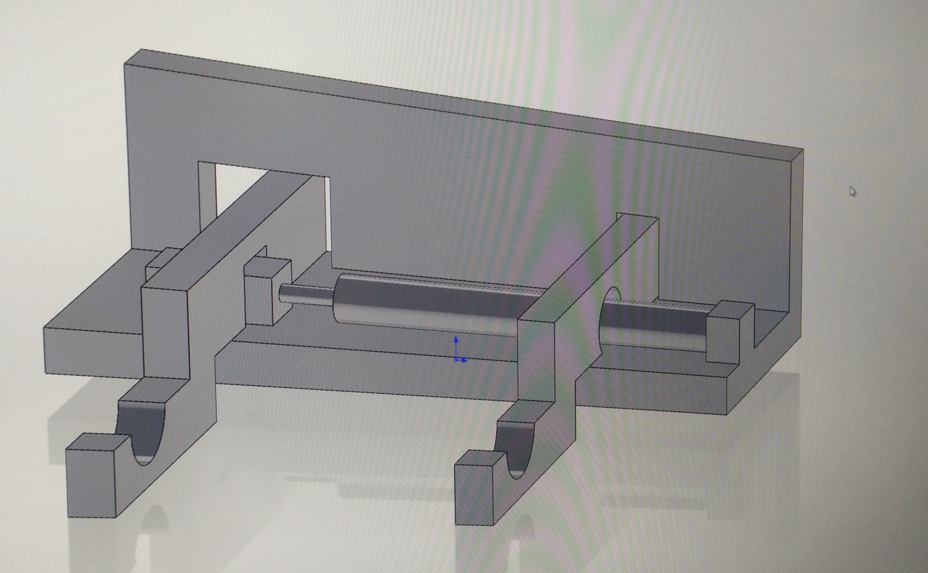
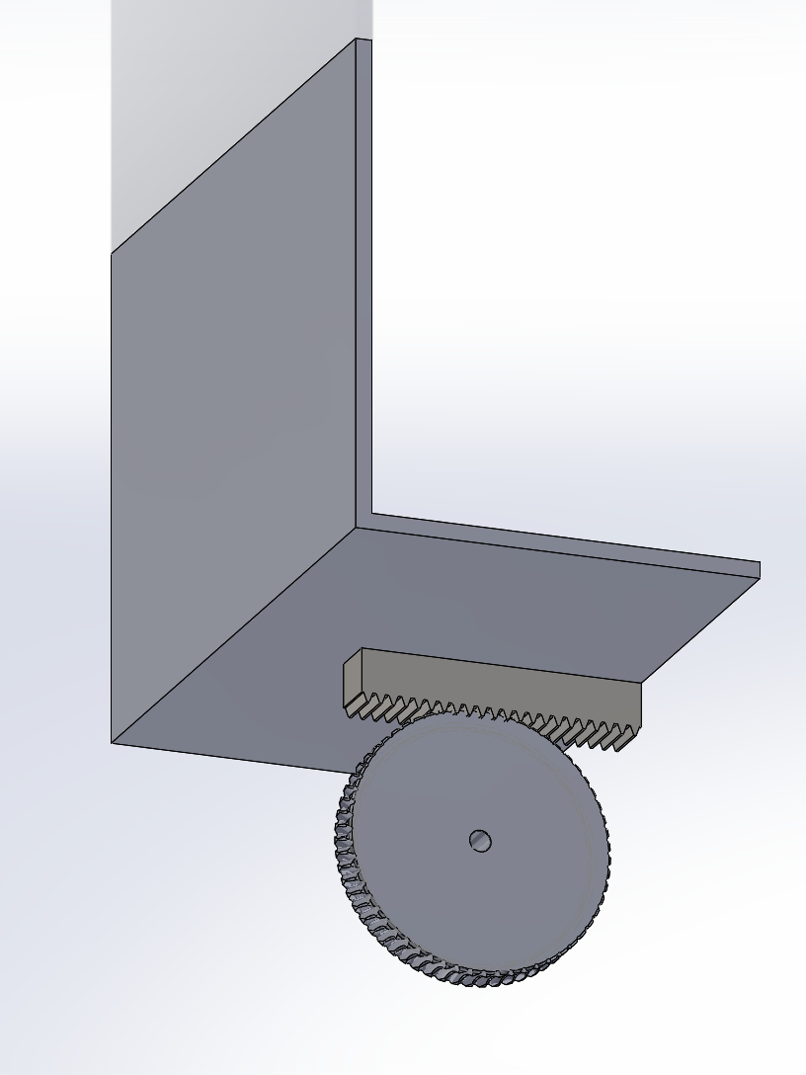
Mechanical Subteam
Max & Sebastian
Mechanisms
Function required of the robot, is to successfully pick up a standard box and transport it securely. Therefore a mechanism to grab the box and one to raise it is necessary.
Forklift style mechanism, which contracts on action of the actuator. This allows for the box to be held securely with addition of the grooved supports.
The forklift allows for the box to be picked up from beneath.
Lift mechanism consisting of a small motor driven gear in contact with a rack. If the motor cannot apply enough torque, the addition of a smaller one can solve this.

Slide 4
Electrical Subteam
Sinéad & Niall
Circuits
Box tester circuit – differentiate between the 3 resonant circuits/ short circuit/ open circuit boxes.
Actuator drive circuit - Activate the actuator driving the grabbing mechanism.
Line follower circuit - Communicate to the software where the robot is in relation to the line.
LED indicator circuit - Indicate which box has been picked up by illuminating specific LEDs.
Deadlines (November 2017)
Considerations
Total permissible current from power supply limited to 0.6A.
Maximum current/ voltage ratings in the box inductor / capacitor.
Contact resistance and possible thermocouples between the box and tester contacts.
Resistances in series with the boxes will alter their characteristics.
Include LEDs to indicate whether sub-circuits are functioning correctly.
Circuit | Design acceptance | Circuit built | Circuit tested
Line follower | 10th | 14th | 16th
Actuator drive | 17th | 23rd | 25th
Box tester | 17th | 23rd | 25th
LED indicator circuit | 17th | 23rd | 25th

Slide 5
Electrical Subteam
Sinéad & Niall
Light sensors
Electrical contacts
Line following circuit
Box testing circuit
Software via addressed PCF8574 chip/ I²C bus
LED indicator circuit
Motor drive circuit (provided)
LEDs
2x large drive motor
(for driving the wheels)
Actuator drive circuit
Pneumatic actuator
(for grabbing mechanism)
1x small drive motor (for lift mechanism)

Slide 6
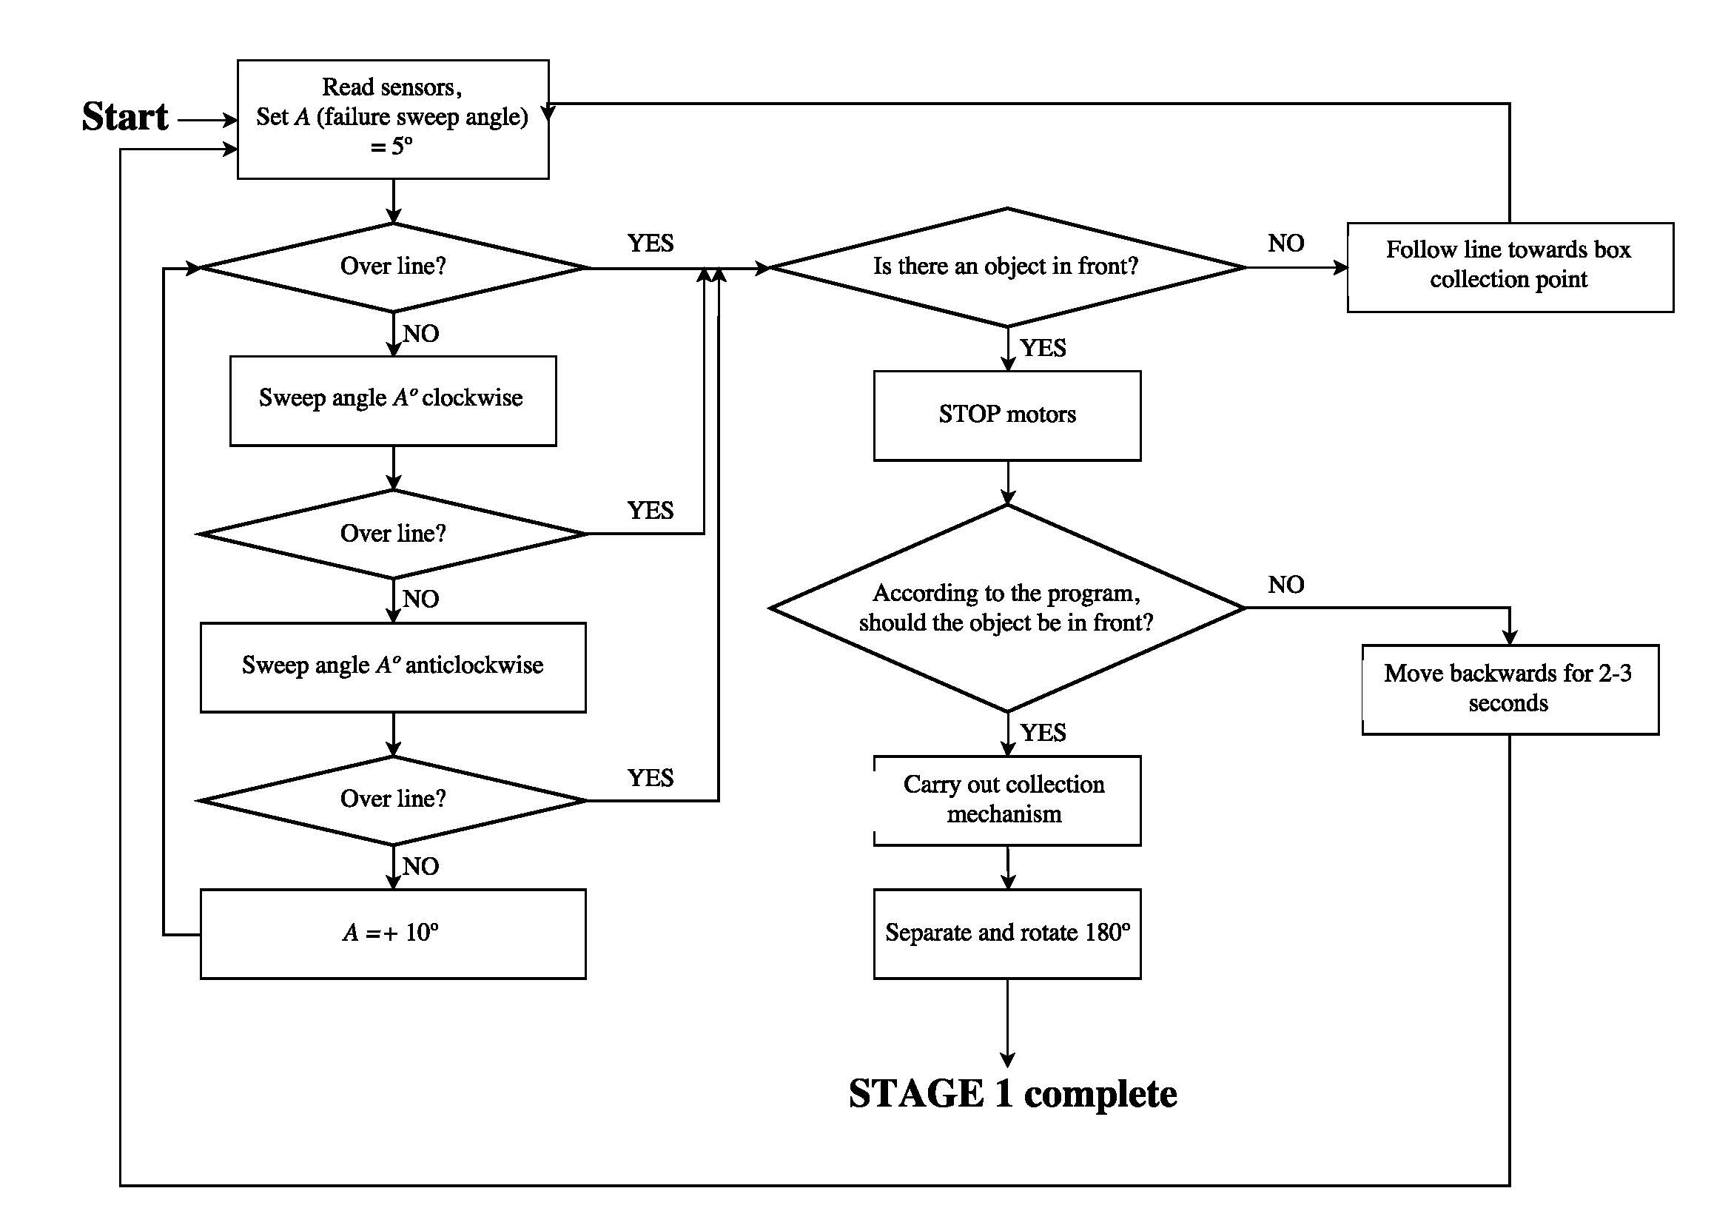
Software Subteam
Alicia, Léa & Diego
Strategy
Collect ONE from a collection point.
Activate the collection mechanism when the sensors have detected the box in front.
Use resonance station on the robot to classify the type of box.
Move towards the turn table or take shortcut depending on the location of the delivery point.
Decide what actions to take to ‘blindly’ (without following the line) deliver the box.
Turn around and move towards another box collection point.

Slide 7
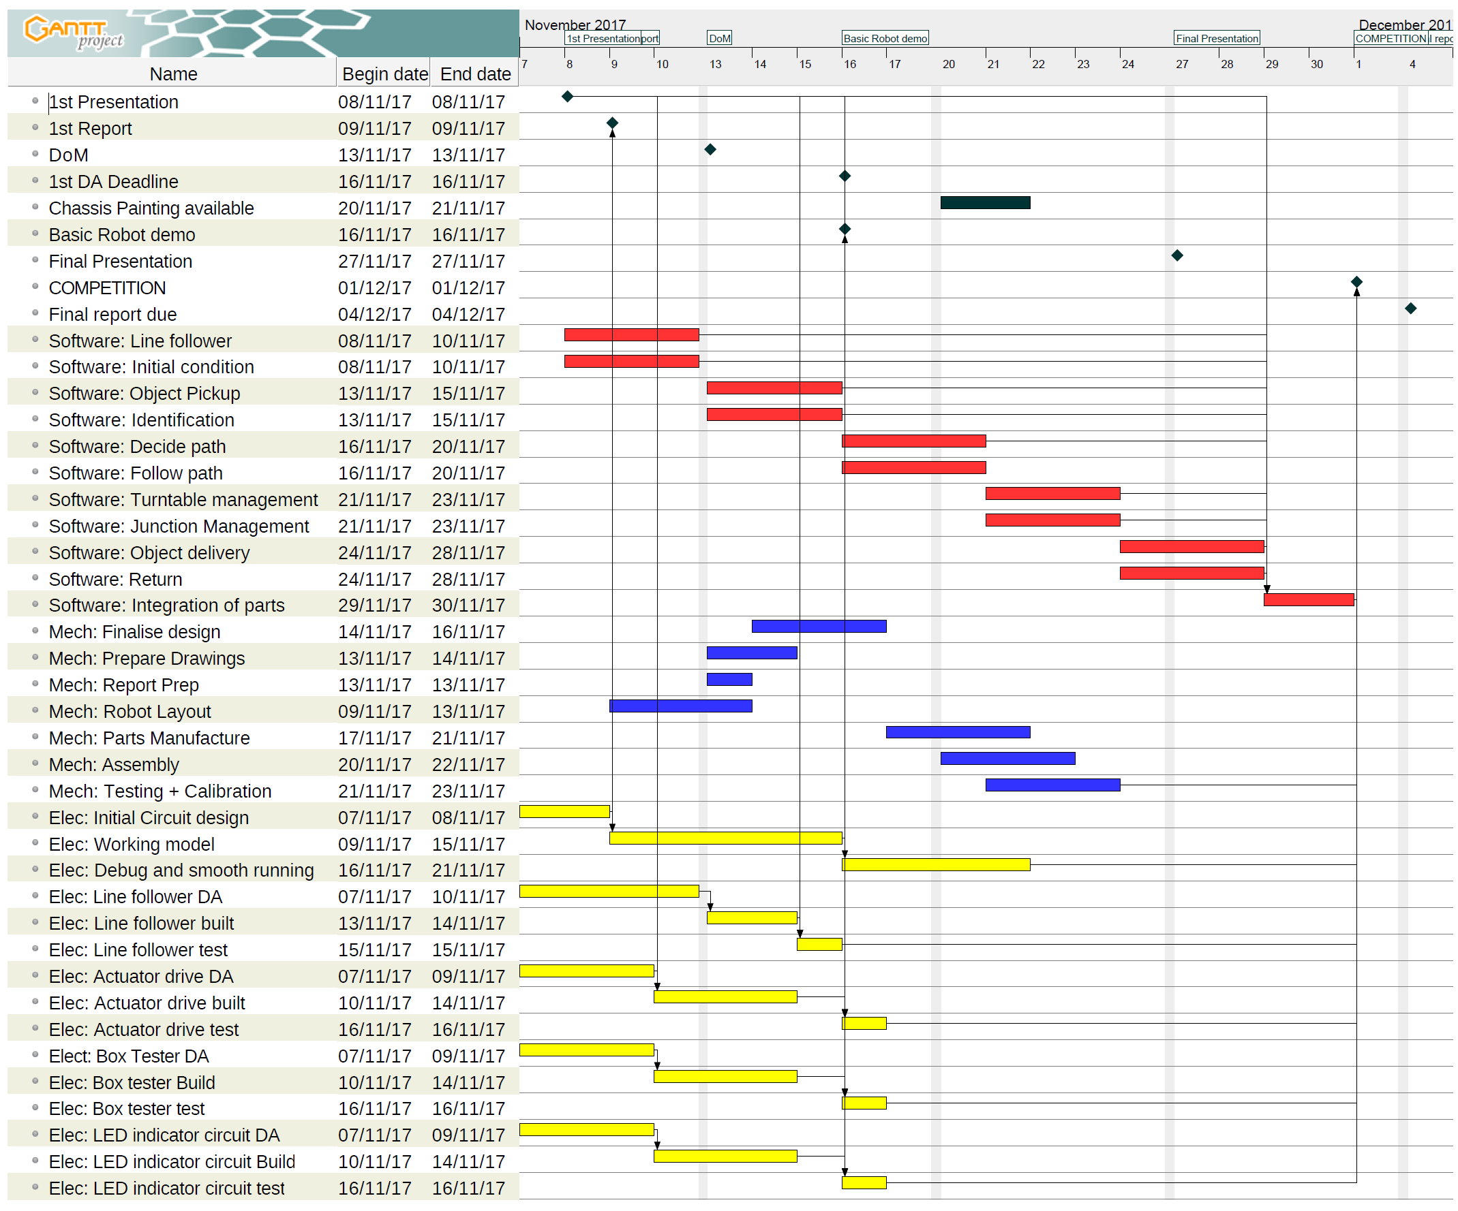
Software Subteam
Alicia, Léa & Diego
Project management
Gantt Chart
Flow chart diagrams
Slack
Github repository
Group meetings after deadlines
Multitasking (whenever possible)

